Slide 1

Identifying Underperforming Utility Sectors in the U.S.
A Data-Driven Strategy to Improve Revenue by 10%
Final Capstone Project
Garth Lo Bello
Data Source: Kaggle.com (US Electricity Prices)

Slide 2
Executive Summary
Final Capstone Project
1
2
3
4
Several U.S. utility sectors underperform in revenue per customer despite having stable customer bases.
Transportation shows the strongest pricing leverage; residential and industrial lag behind.
We propose three strategies:
price optimization, customer growth, and targeted monitoring.
Python simulations and Tableau visualizations support a 10–15% revenue improvement in flagged states.

Slide 3
Problem Statement & Goal
Final Capstone Project
SMART Goal
Identify underperforming utility sectors by state and propose actions to improve revenue by 10% in
12 months.
Business Relevance
Revenue stagnation in key sectors reduces profitability and weakens financial planning.
Why Now
2023–24 data shows widening performance gaps across states.

Slide 4
Final Capstone Project
Data source: Energy Information Administration (EIA), utility data (2001–2024), monthly by state and sector. Kaggle.com
Data & Methodology
Tools: Python (EDA, simulation, forecasting), Tableau (visual storytelling).
Approach: - Data cleansing and aggregation in Python. - Identification of outliers and trends. - Forecasting and strategy modeling. - Visualization and narrative building in Tableau.

Slide 5
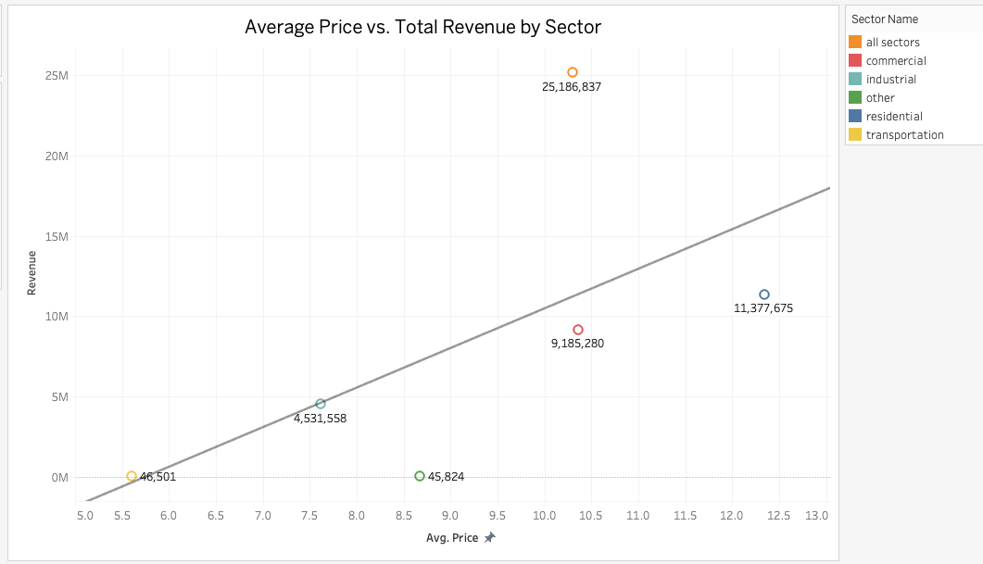
Revenue vs Customer Trends
Final Capstone Project
Most sectors align with the positive price-revenue trend
The upward trendline shows that higher prices are generally associated with higher revenue across sectors, reflecting the expected relationship. Most sectors fall reasonably close to this line.
Industrial Sector (Teal): The industrial sector shows a reasonable price (~$7.6) but low revenue (~$4.5M) and is noticeably below the trendline, indicating significant underperformance. This may point to low customer penetration or inefficiencies despite competitive pricing.
Other Sector (Green): With higher price (~$8.7) but very low revenue (~$46K), this sector is a clear outlier, suggesting either limited application, small customer base, or data sparsity.
Residential Sector (Blue)
With a high average price (~$12.50), the residential sector delivers less total revenue than predicted. It falls below the trendline, suggesting potential issues like low adoption, affordability constraints, or demand suppression.
Customer and revenue values shown on a logarithmic scale.
Commercial Sector (Red)
The commercial sector, priced at around $10.5, lands close to the trendline, indicating a balanced correlation between price and revenue—no strong inefficiency signals.
Transportation Sector (Yellow)
Despite having one of the lowest average prices (~$5.75), the transportation sector sits slightly above the trendline, indicating it generates slightly more revenue than expected based on price alone—possibly due to efficient usage or volume.
Data Source: Kaggle.com (US Electricity Prices)

Slide 6
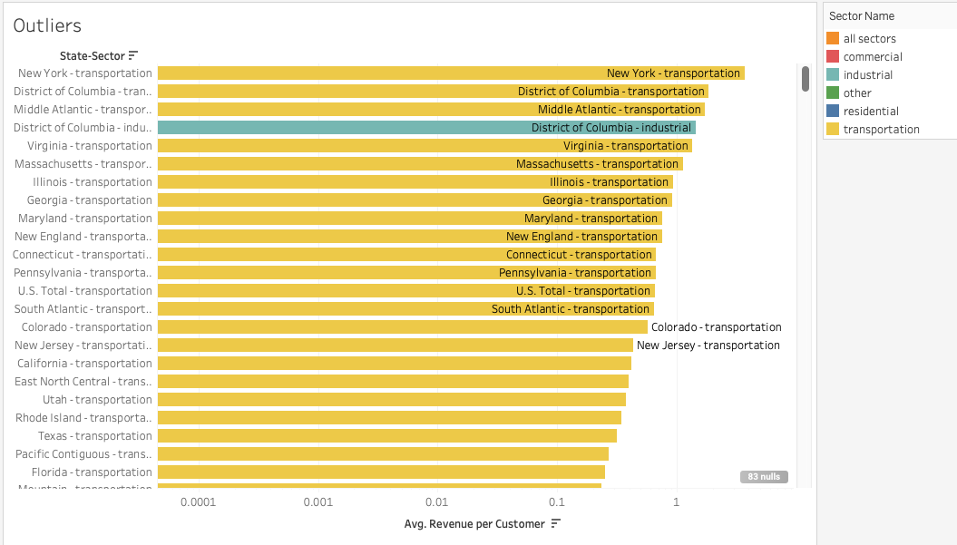
Outlier States Deep Dive
Final Capstone Project
This chart identifies underperforming state-sector combinations based on their average revenue per customer.
Outliers are flagged using a Z-score threshold (±1.0), making it easier to detect statistically significant underperformance.
The x-axis uses a log scale, helping to reveal both subtle and extreme deviations across states and sectors.
Customer and revenue values shown on a logarithmic scale.
Most outliers are concentrated in the transportation sector, with a few also appearing in industrial segments.
These underperforming pairs are persistent, not just occasional dips — suggesting deeper structural issues or pricing inefficiencies.
Recommended next step: prioritize targeted interventions (e.g., price adjustments, infrastructure audits) in the flagged state-sector combinations to boost overall performance.
Data Source: Kaggle.com (US Electricity Prices)

Slide 7
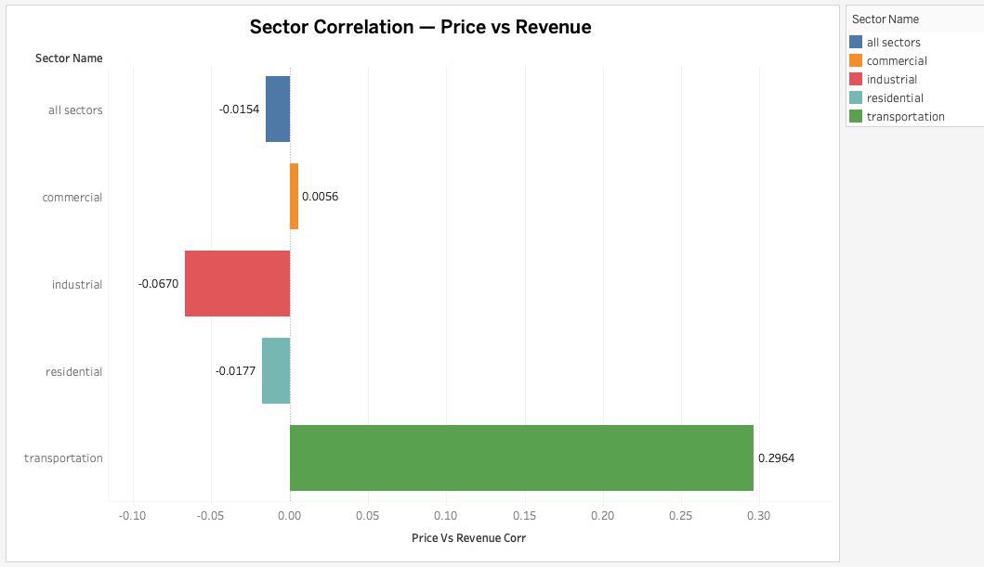
Price vs Revenue Correlation
This bar chart displays the correlation between average price and total revenue for each utility sector.
Residential and industrial sectors show negative or near-zero correlation, indicating that raising prices is unlikely to boost revenue in those segments.
In contrast, the transportation sector exhibits a strong positive correlation (0.2964), suggesting it is more price-sensitive (elastic).
Customer and revenue values shown on a logarithmic scale.
These insights support a targeted pricing strategy—avoiding blanket price hikes and instead focusing on segments with proven responsiveness.
Strategic takeaway: Non-price interventions (efficiency, customer growth) are better suited for price-inelastic sectors.
Data Source: Kaggle.com (US Electricity Prices)
Recommended next step: prioritize targeted interventions (e.g., price adjustments, infrastructure audits) in the flagged state-sector combinations to boost overall performance.
Final Capstone Project

Slide 8
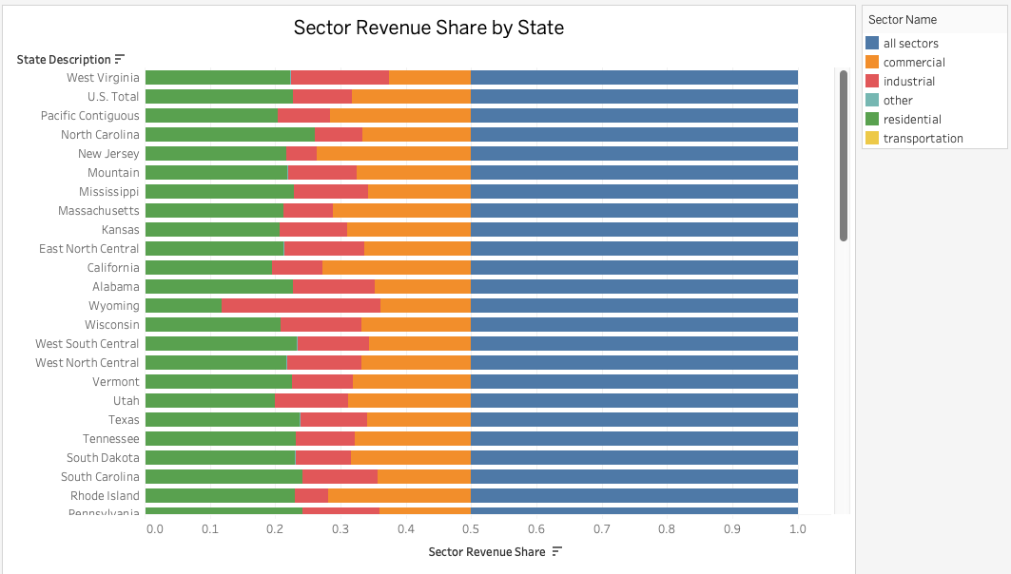
Revenue Share by State — Residential Majority View
Data Source: Kaggle.com (US Electricity Prices)
This chart highlights states with strong residential sector dominance, sorted from highest to lowest residential revenue share.
West Virginia, Mississippi, Vermont, and South Carolina rely heavily on residential consumption—over 50% of their total revenue comes from households.
These states are likely to benefit most from household-focused strategies like efficiency programs, smart metering, or rate design.
Customer and revenue values shown on a logarithmic scale.
The commercial and industrial sectors remain minor contributors in these regions, reducing elasticity for price-based interventions in those areas.
Transportation and "Other" sectors contribute negligibly to total revenue in most residential-heavy states.
Understanding sector concentration ensures that revenue growth strategies are realistic and demand-aligned.

Slide 9
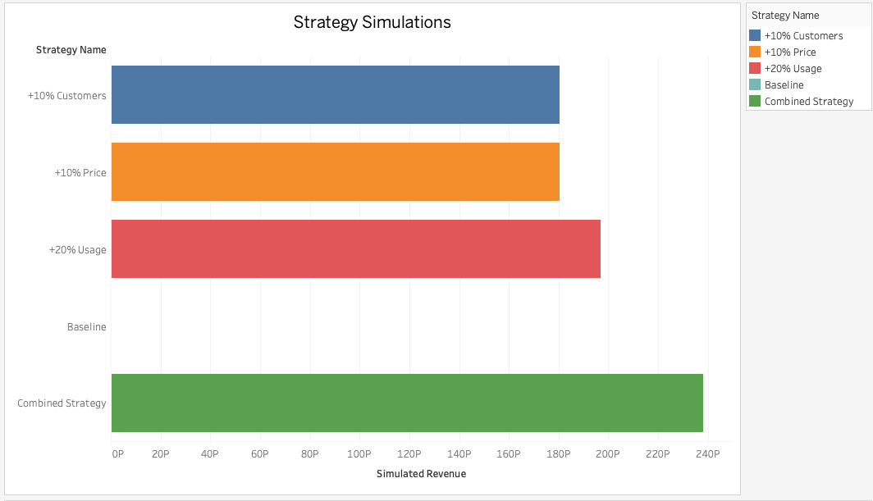
Strategic Forecasting & Simulated Scenarios
Final Capstone Project
This chart displays simulated revenue projections under different strategic interventions.
Each bar represents a modeled outcome from one strategy applied to underperforming sectors.
+20% Usage and +10% Price produced moderate gains, while the Combined Strategy significantly outperformed all others.
Customer and revenue values shown on a logarithmic scale.
The model shows that stacked improvements in usage, price, and customer base can raise revenue well above baseline targets.
This confirms the feasibility of a 10%+ revenue improvement goal, validating the use of data-driven simulation to guide planning.
Data Source: Kaggle.com (US Electricity Prices)
Recommended next step: prioritize targeted interventions (e.g., price adjustments, infrastructure audits) in the flagged state-sector combinations to boost overall performance.

Slide 10
Conclusion & Next Steps
Encourage Efficient Usage Growth
Promote electrification (EVs, heat pumps, electric transit) in targeted areas to raise baseline usage responsibly.
Implement Time-of-Use pricing to shift load to off-peak hours, increasing revenue without stressing infrastructure.
Expand demand response programs to manage growth while ensuring grid stability.
Final Capstone Project
This analysis identified consistent underperformance in specific state-sector utility segments, particularly within transportation and industrial sectors. Through pricing analysis, revenue trends, and simulated strategy modeling, we found actionable opportunities to drive revenue growth of 10% or more.
01
04
02
03
Target Underperforming State-Sector Pairs
Prioritize intervention in consistently underperforming areas (e.g., transportation sectors in states like New York, D.C., and Virginia).
Focus on regions with large customer bases but low revenue per customer to maximize impact.
Customize solutions by sector — e.g., pricing for residential, demand-side programs for transportation.
Explore Price Adjustments Where Elasticity Exists
Apply price increases in sectors with positive price-revenue correlation (e.g., transportation) to test elasticity-driven growth.
Avoid price hikes in sectors with weak or negative correlation (e.g., industrial or residential), where it may suppress demand.
Pilot regional pricing strategies before full rollout.
Scale Successful Strategies from Simulation
Use simulated outcomes (+10% price, +10% customer, +20% usage, combined) as blueprints for real-world initiatives.
Prioritize the combined strategy (highest simulated gain) in regions with operational flexibility.
Monitor results and refine strategies using ongoing forecasting and scenario modeling.

